Slide 1
IMEI abuse on Android smartphones
By B216
Christian Jødal O’Keeffe,
Nicolai Kjær Skovhus,
Dag Toft Børresen Pedersen,
Stefan Mathias Holst Christiansen,
Thais Alexander Jones,
and Rasmus Fischer Gadensgaard

Slide 2
Disposition
Short introduction & Problem analysis
Theory of IMEI, IMSI, and Android
Theft of cellphones and IMEI
Legal and illegal usage of IMEI
Conclusion & process analysis

Slide 3
Introduction
IMEI and IMSI abuse on Android smartphones
Why did we choose this topic
400.000 Android phones are activated every day
Android Applications can read the IMEI and IMSI numbers
But the problem is writing new IMEI and IMSI numbers to a phone.
Our problem statement:
Why can apps on Android-phones get the IMEI, and what consequences can it have?

Slide 4

IMEI, IMSI and Android
IMEI is the identity number of the phone
IMSI is the identity number of the SIM
Android is an operating system to smartphones and tablets

Slide 5
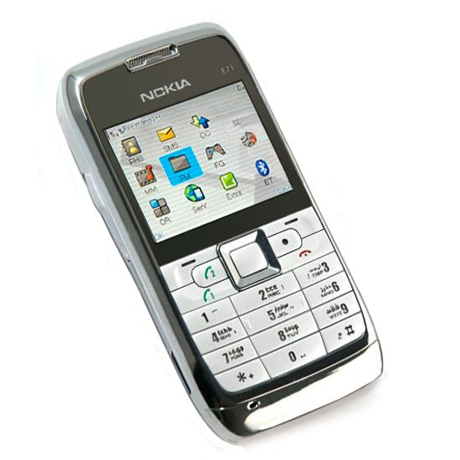
Theft of cellphones and IMEI
Cellphone Theft
Legal sales
Illegal sales
Fakes
IMEI Theft
Spiderman kit

Slide 6
Legal usage of IMEI
Law of IMEI
Legal use
What does the user use the IMEI number to?
What can apps use IMEI to?

Slide 7
Illegal use
Popular among criminals
Used to track, therefor used as disguise
Copy of identity
IMEI and IMSI is needed
TelephonyManager library use getSubscriberId
Identity copied by obtaining IMEI & IMSI
Trojans used to obtain the IMEI & IMSI

Slide 8
Illegal IMEI implants
China phones made without ore with zero IMEI’s
Indian market affected due to acts against terror
Examples of IMEI abuse
Cloning
Fake IMEI
Consequences of an stolen/copied IMEI

Slide 9
Conclusion
IMEI and IMSI numbers can be obtained by Android apps.
IMEI number is a great way to uniquely identify the phone.
These numbers can be sent to a third part.
It is possible to copy the identity of a phone.

Slide 10
Conclusion
Surveillance through the IMEI number is possible.
We still have to find a reason for the IMEI and IMSI numbers not to be encrypted.
Google needs find a solution

Slide 11
Process analysis
Discussed and choose a subject.
Researching for good/reliable sources.
Divided parts which each other should write.
Corrections to streamline the work.
We stayed within our working schedule, and kept our promises.
Our supervisor was a big help

Slide 12
Process analysis - Synthesis
What we need to do better: | What we should keep doing:
We need to get better at meeting at the same time. We need to discuss the level of ambition. We need to have a meeting every morning, and write down what we have done, and what we will do for the rest of the day. We need a written time schedule. We also need to be better prepared for the meetings with our supervisor. | We should keep dividing subjects out to write individually. We should still have no specific team leader.

Slide 13
Questions?

